Slide 1
Machine Learning In a Day Workshop
Technology Solution Professional, Data & AI
Ahmed Sherif

Slide 2
Agenda
Quick Introduction
Techniques
Process
Tools
Demo

Slide 3
Quick Introduction

Slide 4
What is Machine Learning?
Machine Learning is the study of the building blocks of systems that can learn from data
How can Machine Learning help you?
As part of a digital transformation, we can begin to make decisions based on data instead of only going with our gut instinct

Slide 5
What is Machine Learning?
“Learning is any process in which a system improves performance by experience.”
“Machine Learning is concerned with computer programs that automatically improve their performance with experience”
--Herbert Simon
Turing Award 1975
Nobel Prize in Economics 1978

Slide 6
Why Machine Learning now?
Flood of Data
Increasing computational power
Growing progress in available algorithms from researchers
Growth of open source
Support from Industries

Slide 7

Data Science, AI, and Machine Learning
AI
Focus on core human abilities such as vision, speech, language, decision making, and other complex tasks
Machine Learning
Create models that predict, prescribe, group, or identify
Designing machines and software to emulate these processes.
Data Science
Notes:
https://www.datasciencecentral.com/profiles/blogs/difference-between-machine-learning-data-science-ai-deep-learning
Normalize the bullets in some way

Slide 8
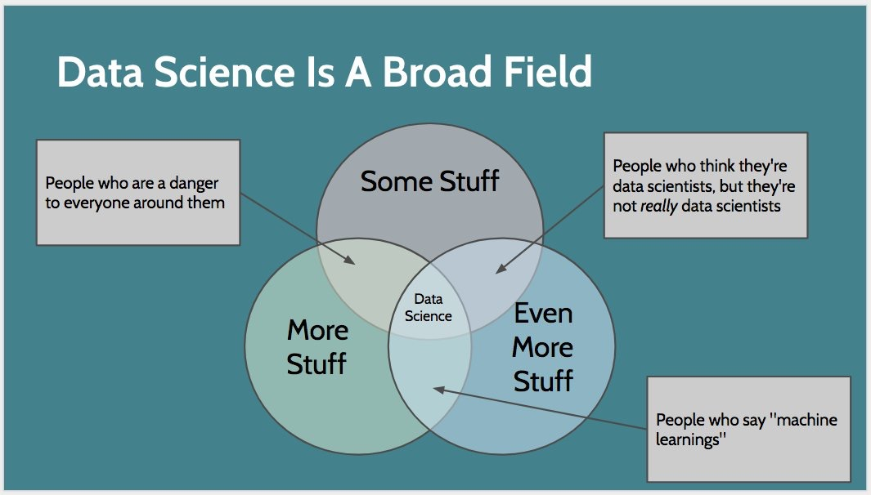
Notes:
https://www.datasciencecentral.com/profiles/blogs/difference-between-machine-learning-data-science-ai-deep-learning
Normalize the bullets in some way

Slide 9
Is Machine Learning a new concept?
The term Machine Learning may be relatively new
The algorithms behind them are anything but new

Slide 10
Techniques

Slide 11

Classification
Identifying to which of a set of categories (sub-populations) a new observation belongs, on the basis of a training set of data containing observations (or instances) whose category membership is known.
Is the movie coming out Fresh or Rotten?

Slide 12

Regression
A set of statistical processes for estimating the relationships among variables. It includes many techniques for modeling and analyzing several variables, when the focus is on the relationship between a dependent variable and one or more independent variables (or 'predictors’).
How much money did the movie make?

Slide 13

Clustering
The task of grouping a set of objects in such a way that objects in the same group (called a cluster) are more similar (in some sense) to each other than to those in other groups (clusters).
Which customers are the most similar?
Can we create groups from this data?
I don’t know anything about these entities where do I start?

Slide 14
Anomaly Detection
The identification of items, events or observations which do not conform to an expected pattern or other items in a dataset. Typically the anomalous items will translate to some kind of problem such as bank fraud, a structural defect, medical problems or errors in a text.
How can we spot possible fraud?
Can I automate identifying outliers?

Slide 15
Other use cases
Spam Email Detection
Image Search
Amazon Recommendations
Speech Understanding
Sentiment Analysis
Face Detection

Slide 16
Process

Slide 17
Supervised vs Unsupervised Learning
Unsupervised Learning
Supervised learning
Unlabeled Data
Clustering (K-means)
Market Basket Analysis (Apriori Algorithm)
Anomaly Detection (Extreme Studentized Deviate Test)
Text mining (Latent Dirichlet Allocation)
Labeled Data
Anomaly Detection (Support Vector Machine)
Text mining (Support Vector Machine)
Regression (Linear Regression)
Classification (Random Forest)
Sentiment analysis (Neural Network)
Not mutually exclusive
Notes:
Ryan to workshop think in a diagram

Slide 18
Algorithm selection (Supervised Learning)
Supervised
Regression
Multi-Class Classification
2-Class Classification
Ordinal
Poisson
Logistic Regression
Neural Network
Support Vector Machine
Averaged Perceptron
Fast Forest Quantile
Linear
Decision Forest
Decision Jungle
Logistic Regression
Bayes Point Machine
Bayesian Linear
Neural Network
XGBoost
Decision Forest
Boosted Decision Tree
Decision Forest
Boosted Decision Tree
Decision Jungle
Locally Deep Support Vector Machine
ARIMAX
XGBoost
Neural Network
XGBoost
Notes:
Steal from cheat sheet. Color each path distinct

Slide 19
Algorithm selection (Unsupervised Learning)
Unsupervised
Anomaly Detection
Clustering
PCA-Based Anomaly Detection
One-Class Support Vector Machine
K-Means
Hierarchical
Extreme Studentized Deviate Test
Notes:
Steal from cheat sheet. Color each path distinct

Slide 20
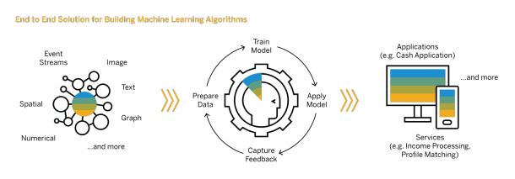
All models are wrong…but some are useful!
Notes:
Steal from cheat sheet. Color each path distinct

Slide 21
Tools

Slide 22






Machine Learning Options on Azure
Pre-Built
Custom
COGNITIVE SERVICES
ML SERVER
AZURE
DATABRICKS
BOT SERVICE
AZURE ML Studio

Slide 23
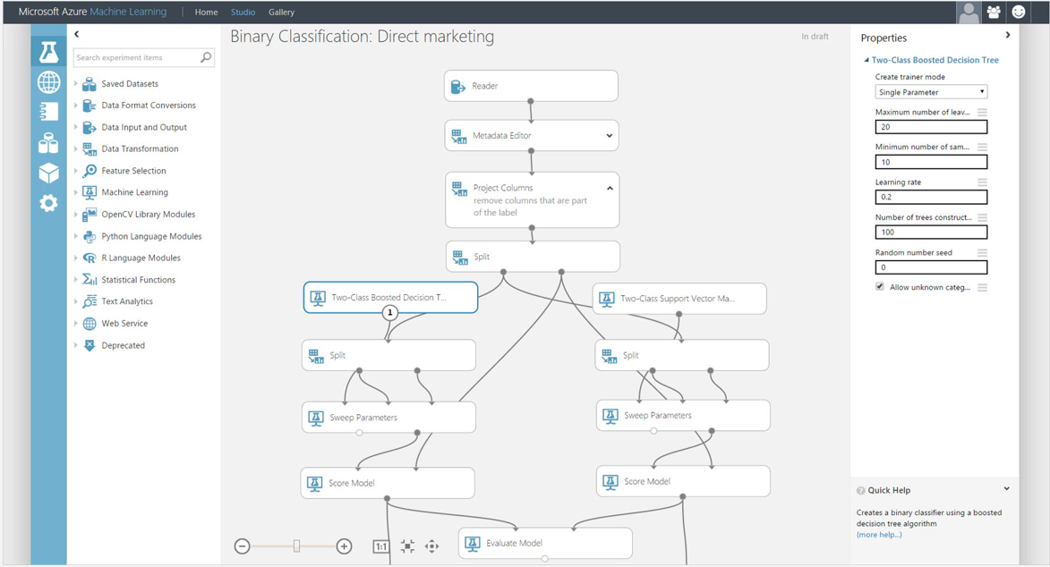
Azure Machine Learning Studio
Visual drag-and-drop

Slide 24



What is Azure Databricks?
A fast, easy and collaborative Apache® Spark™ based analytics platform optimized for Azure
Best of Databricks
Best of Microsoft
Designed in collaboration with the founders of Apache Spark
One-click set up; streamlined workflows
Interactive workspace that enables collaboration between data scientists, data engineers, and business analysts.
Native integration with Azure services (Power BI, SQL DW, Cosmos DB, Blob Storage)
Enterprise-grade Azure security (Active Directory integration, compliance, enterprise-grade SLAs)
Notes:
Azure Databricks features –
Enhance your teams’ productivity
Get started quickly by launching your new Spark environment with one click.
Share your insights in powerful ways through rich integration with PowerBI.
Improve collaboration amongst your analytics team through a unified workspace.
Innovate faster with native integration with rest of Azure platform.
Build on the most compliant and trusted cloud
Simplify security and identity control with built-in integration with Active Directory.
Regulate access with fine-grained user permissions to Azure Databricks’ notebooks, clusters, jobs and data.
Build with confidence on the trusted cloud backed by unmatched support, compliance and SLAs.
Scale without limits
Operate at massive scale without limits globally.
Accelerate data processing with the fastest Spark engine.

Slide 25



Azure Databricks key audiences & benefits
Data scientist
Data engineer
CDO, VP of analytics
Integrated workspace
Easy data exploration
Collaborative experience
Interactive dashboards
Faster insights
Best Spark & serverless
Databricks managed Spark
Improved ETL performance
Zero management clusters, serverless
Easy to schedule jobs
Automated workflows
Enhanced monitoring & troubleshooting
Automated alerts & easy access to logs
Zero Management Spark
Cluster democratization (serverless)
Fast, collaborative analytics platform accelerating time to market
No dev-ops required
Enterprise grade security
Encryption
End-to-end auditing
Role-based control
Compliance
Unified analytics platform
Provided by Microsoft and Databricks under NDA

Slide 26
Workshop

